Slide 1
The Process and Stages of Systems Design
Systems Design
Chapter 09

Slide 2
Objectives
By the end of this chapter, you should know –
The process of system design.
How logical design differs from physical design.
Top-down design and physical decomposition.
Forms-driven methodology.
Audit considerations for system development.

Slide 3
Introduction
By having crystal clarity of the process and stages of system design one can –
Translate the system requirements into ways of operationalizing them.
Initiate the design process of a system – logical design and physical design.
Understand what design methodology to use basing on system requirements and context.
Identify and implement the major design activities of a system design process.
Perceive different audit considerations while designing a system.

Slide 4
The Process of Design
The design phase focuses on the detailed implementation of the system recommended in the feasibility study.
Emphasis is on translating performance specifications into design specifications.
The design phase is a transition from a user-oriented document (system proposal) to a document oriented to the programmers or database personnel.
System design goes through two phases of development –
Logical Design
Physical Design

Slide 5
Logical Design
The logical design of an information system is developed during the system analysis phase usually.
The logical design defines the functions and features of the system and the relationships among its components virtually.
The logical design mainly includes the output that must be produce by the system, the input needed by the system and the process that must be produced by the system without regard to how tasks will be accomplished physically.
A logical design defines “what” must take place, not “how” it is to be accomplished.
Logical designs do not address the actual methods of implementation.

Slide 6
Logical Design: Example
The logical design of a “Customer Record System”
Describes the data that must be entered for each customer.
Specifies that records must be displayed in customer number order.
Explains what information to produce for a customer status report.
Specifications for the actual input or data entry procedure, the data sorting method, the physical process of creating the report and the exact format of the report are NOT part of the logical design.

Slide 7
Logical Design
The logical design of a system typically covers the following –
Reviews the current physical system –data flows, file content, volumes, frequencies etc.
Prepares output specifications – format, location, content and frequency of reports.
Prepares input specifications – format, location, content and frequency of reports; flow from input data source to the actual input location.
Prepares edit, security, backup procedure and control specifications.
Prepares a logical design walkthrough of the information flow, output, input, controls and implementation plan.
Reviews benefits, costs, target dates and system constraints.
Data flow diagram, E-R diagram modeling are mainly used for logical design of an IS.

Slide 8
Physical Design
The physical design of an information system is a plan for the actual implementation of the system.
The physical design of an information system is developed during the system design phase generally.
The physical design is built on the system’s logical design and describes a specific implementation, much like a working blueprint describes that actual construction of a building.
The physical design describes the actual process of entering, verifying and storing data, the physical layout of data files, the sorting procedures, the exact format of reports and so on.

Slide 9
Physical Design: Example
The physical design of a “Customer Record System”
Describes the data type, data field integrity, attribute definitions that must be entered for each customer.
Specifies the sorting procedure for displaying the customer record.
Specifies how to generate and display customer status report from input data.
Normalized relations, Volume estimates, Response time expectations, Data security needs, Backup/recovery needs, DBMS technology used are some of the concerns too.

Slide 10
Physical Design
The physical design of a system typically covers the following –
Specify input/output media, design database and specify backup procedures, design physical information flow and walkthrough of the system.
Prepare a conversion schedule and target date.
Determine training procedure, courses and timetable.
Devise a test and implementation plan and specify any new hardware/software.
Update benefits, costa, conversion date and system constraints (legal, financial, hardware etc.)
Different programming language for software, DBMS technology and hardware implementation are mainly used for physical design of an IS.

Slide 11
Relationship Between Logical and Physical Design
Logical design is concerned with WHAT the system must accomplish, physical design is concerned with HOW the system will meet those requirements.
Good system design is impossible without careful, accurate system analysis.
The design phase typically cannot begin until the analysis work is complete.
It is better to complete the analysis phase before moving on to systems design.

Slide 12
Design Methodologies
In order to transform user requirements into a more clearly defined design new techniques and methodologies have been initiated which attempt to do the following –
Improve productivity of analysts and programmers.
Improve documentation and subsequent maintenance and enhancements.
Cut down drastically on cost overruns and delays.
Improve communication among the user, analyst, designer and programmer.
Standardize the approach to analysis and design.
Simplify design by segmentation.

Slide 13
Design Methodologies
There are broadly three types of design methodologies –
1. Structured Design
Structured Chart using Functional Decomposition
2. Form-Driven Methodology – The IPO Charts
HIPO and IPO Charts
3. Structured Walkthrough
User Involvement

Slide 14
Structured Design
Structured design is a data-flow based methodology that helps in identifying the input and output of the developing system.
The main objective of structured design is to minimize the complexity and increase the modularity of a program.
In structured designing, the system specifications act as a basis for graphically representing the flow of data and sequence of processes involved in a software development with the help of DFDs.
After developing the DFDs for the software system, the next step is to develop the structure chart.

Slide 15
Structured Design - Modularization
Modularization or decomposition is an approach that minimize the complexity to manage the problem by subdividing it into smaller segments.
Modularization can follow Top-Down approach or Bottom-Up approach.
Top-Down Strategy
The top-down strategy is called so because it starts from the top or the highest-level module and moves towards the lowest level modules.
Bottom-Up Strategy
The Bottom-Up strategy is called so because it starts from the bottom or the most basic level modules and moves towards the highest level modules.

Slide 16
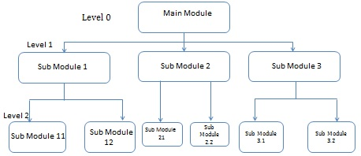
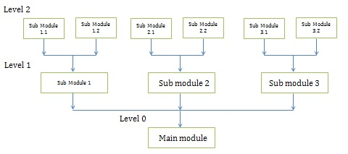
Structured Design - Modularization

Slide 17
Structured Design
Structured design partitions the program into small and independent modules. These are organized in top down manner with the details shown in bottom.
Thus, structured design arises from the hierarchical view of the application rather than the procedural view. The top level shows the most important division of work; the lowest level at the bottom shows the details.
Advantages
Critical interfaces are tested first.
It provide abstraction.
It allows multiple programmers to work simultaneously and allows code reuse.
It provides control and improves morale.
It makes identifying structure easier.

Slide 18
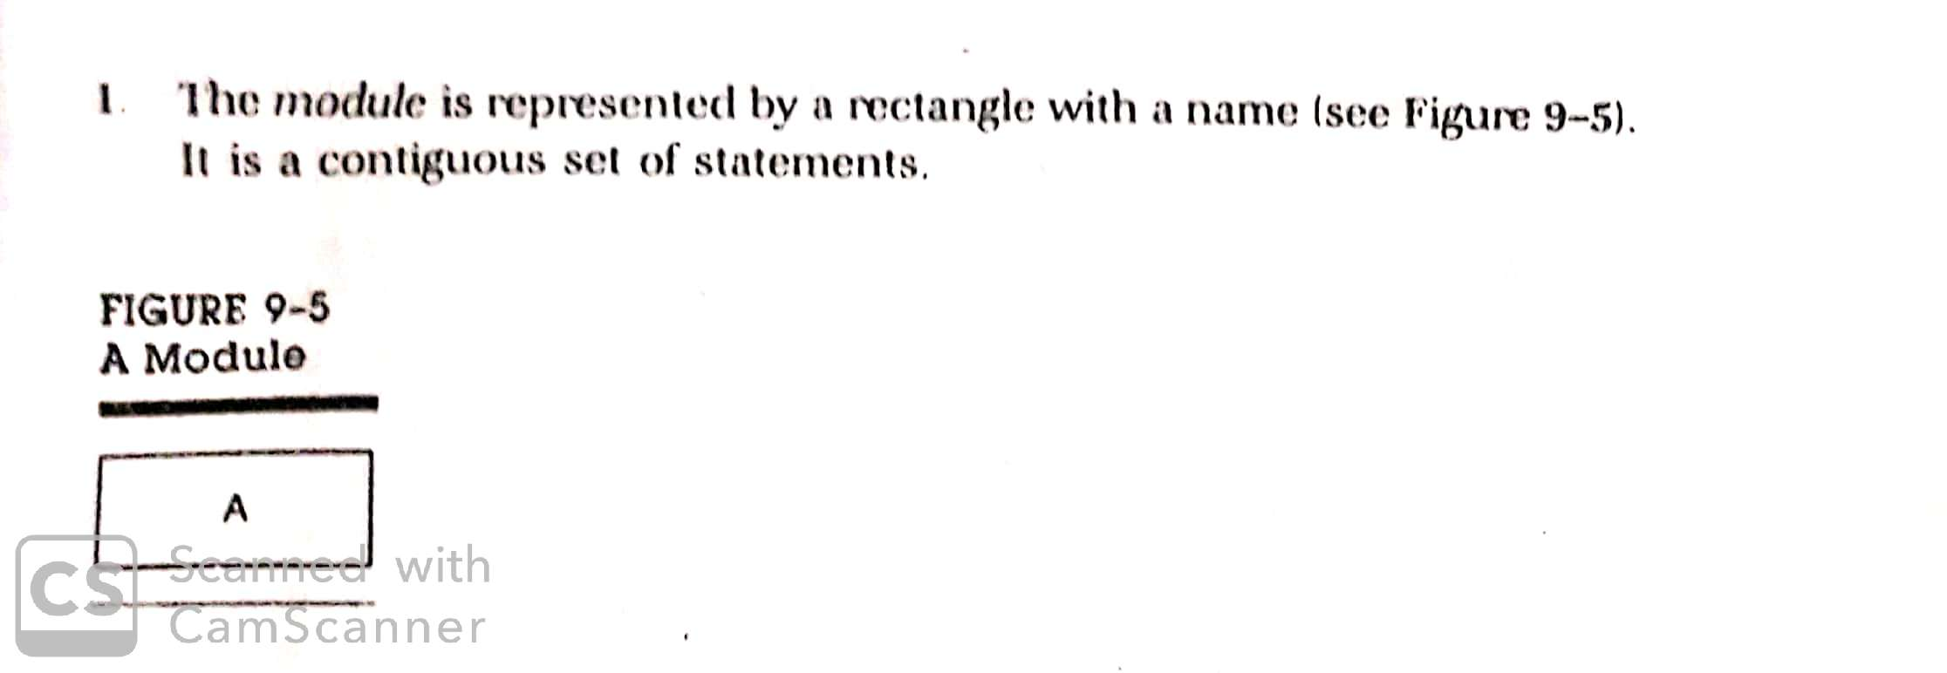
Structured Design: Functional Decomposition
The documentation tool for structured design is the hierarchy or structured chart. It is a graphic tool for representing hierarchy and it has three elements.

Slide 19
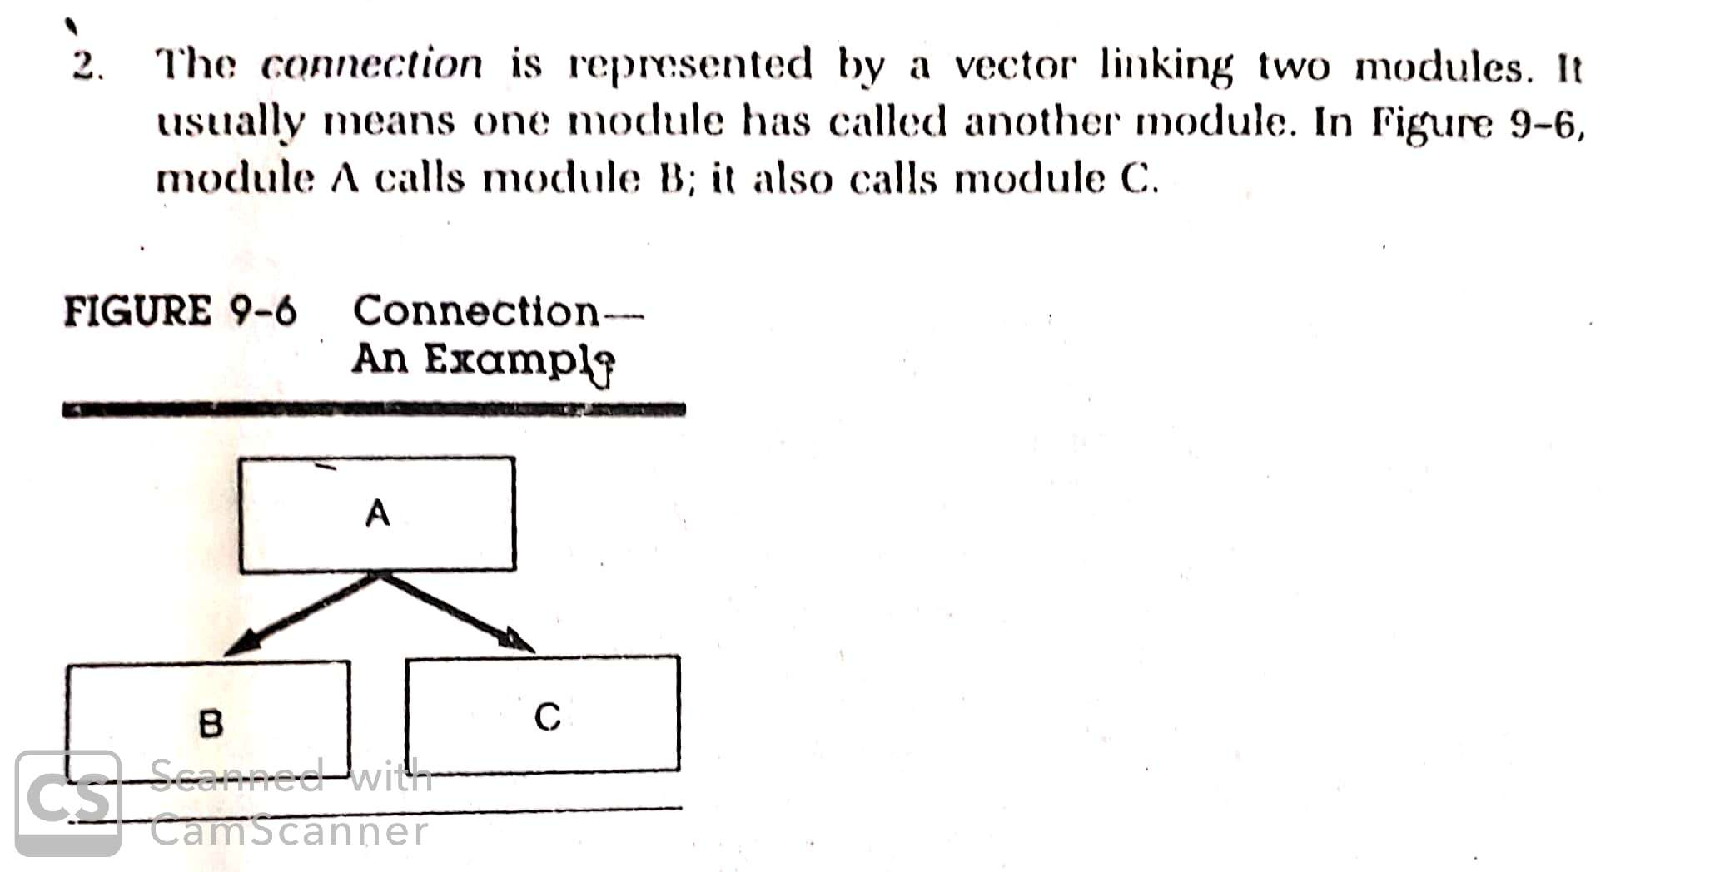
Structured Design: Functional Decomposition
The documentation tool for structured design is the hierarchy or structured chart. It is a graphic tool for representing hierarchy and it has three elements.

Slide 20
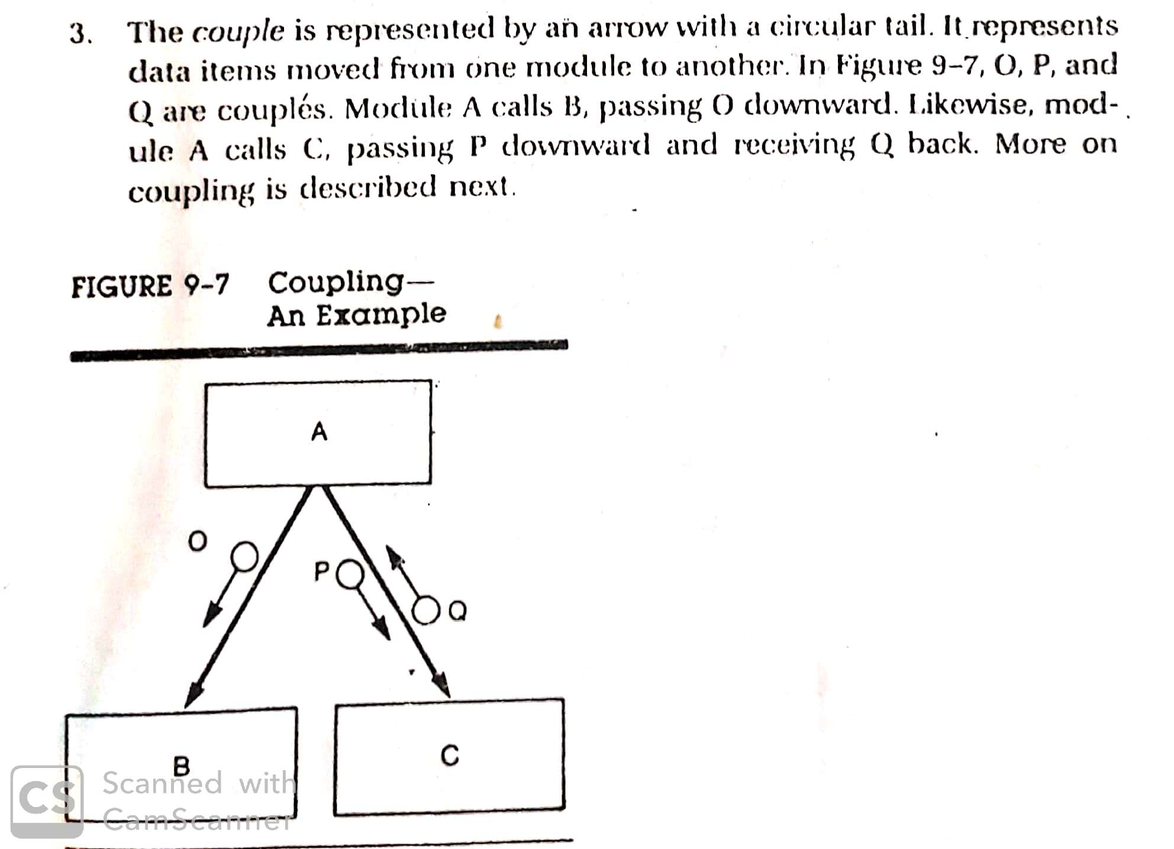
Structured Design: Functional Decomposition
The documentation tool for structured design is the hierarchy or structured chart. It is a graphic tool for representing hierarchy and it has three elements.

Slide 21
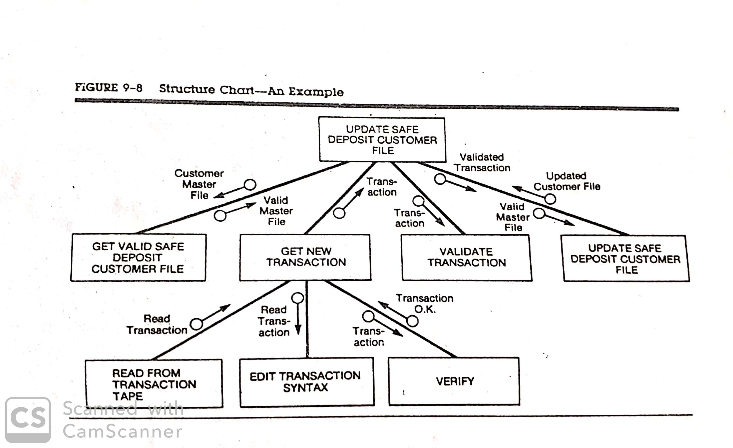
Structured Design: Functional Decomposition

Slide 22
Structured Design: Functional Decomposition (Evaluation)
In the functional decomposition approach to structured design, software is partitioned into independent modules so that each module is small enough to be manageable.
In the evaluation of a program module, two criteria are considered:
Module Coupling
Refers to the no. of connections between a “calling and a “called” module and the complexity of these connections. There must be at least one connection between a module and a calling module to make modules as independent as possible.
Module Cohesion
Refers to the relationship among elements (instructions) within a module. If a module does more than one discrete task, they are said to be closely bounded and modules that perform only one task are said to be strongly cohesive than those that perform multiple tasks.

Slide 23
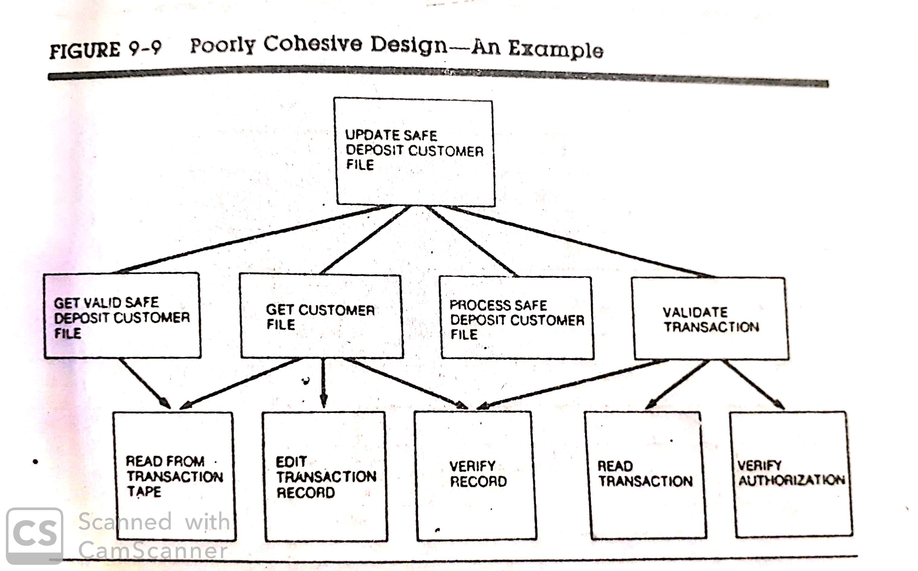
Structured Design: Functional Decomposition (Evaluation)

Slide 24
Forms-Driven Methodology – The IPO Charts
In structured design a hierarchy chart represents a good program design if it meets the criteria of cohesion and coupling.
Each module performs a single function and should be independent of the rest of the program.
Each criterion calls for more details than are available.
This prompts the analyst to develop input/process/output (IPO) charts for each module in the hierarchy chart (HIPO).
IPO and HIPO are forms-driven technique where standard forms are used to document the information.
It was developed by IBM as a design aid and implementation technique.

Slide 25
Forms-Driven Methodology – The IPO Charts
It describes the data input and output from processes and defines the data flow composition. The objectives are –
Provide a structure by which the functions of a system can be understood.
State the functions to be performed by the program rather than specifying the program statements to be used to perform the functions.
Provide a visual description of input to be used and output to be produced for each level of the diagram. It helps to make the transformation of input to output data visible of a system.

Slide 26
The IPO Charts
Its aim is to describe the input, processing and output of a program.
Shows more details/information about:
What data items are input?
What processing takes place on each specific data?
Which information is output?
Sequence of completing IPO chart –
Input
Process
Output

Slide 27
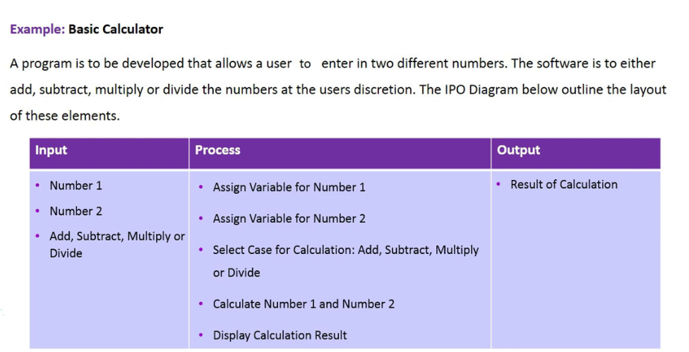
The IPO Charts (Example)

Slide 28
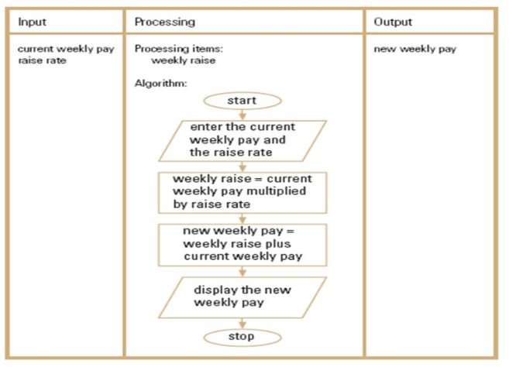
The IPO Charts (Example)

Slide 29
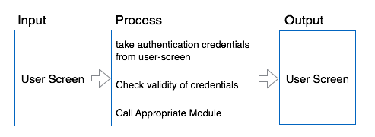
The IPO Charts (Example)

Slide 30
The HIPO Charts
HIPO (Hierarchical + Input Process Output) diagram is a combination of two organized method to analyze the system and provide the means of documentation.
It consists of –
A hierarchy chart that graphically represents the program’s control structure (the top-down structure).
A set of IPO (Input-Process-Output) charts that describe the inputs to, the outputs from, and the functions (or processes) performed by each module on the hierarchy chart.
Strength: The hierarchy chart serves as a useful planning and visualization document for managing the program development process.
Weakness: The “text plus flowchart” nature of the IPO charts makes them difficult to maintain. So the documentation often does not represent the current state of the program.

Slide 31
How to Generate the HIPO Charts?
HIPO uses easy-to-draw vector like symbols between processes that define data communication and data direction.
The procedure for generating HIPO diagram is –
Begin at the highest level of abstraction and define the inputs to the system and the outputs from t in aggregate terms.
Identify the processing steps by those that convert input into output.
Document each element using HIPO diagram notation and the associated treelike structure.
Identify sub processes and their respective inputs and outputs. Continue decomposition until the processes cannot be decomposed any further.

Slide 32
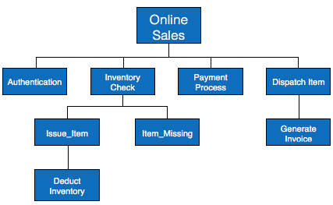
The HIPO Charts (Example)

Slide 33
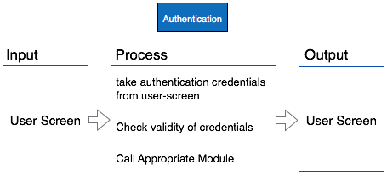
The HIPO Charts (Example)

Slide 34
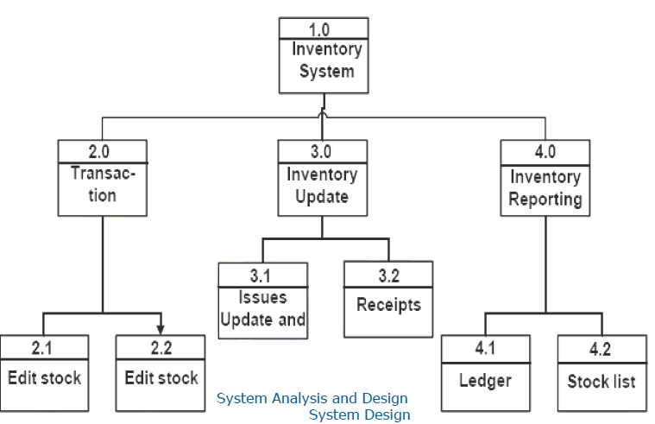
The HIPO Charts (Example)

Slide 35
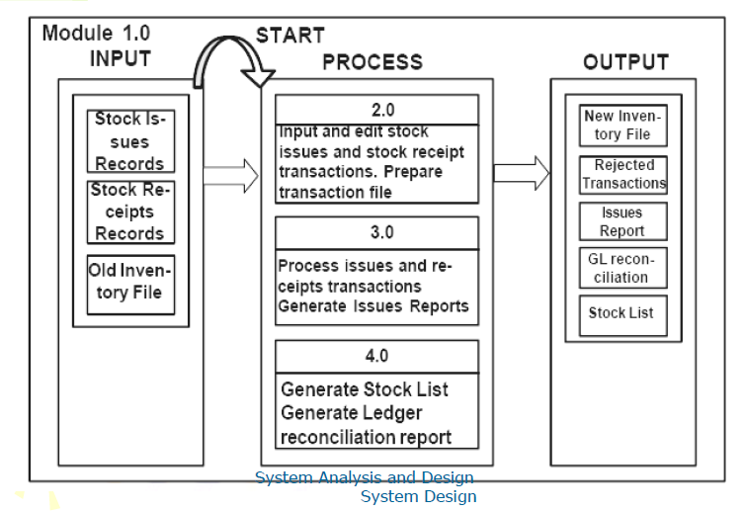
The HIPO Charts (Example)

Slide 36
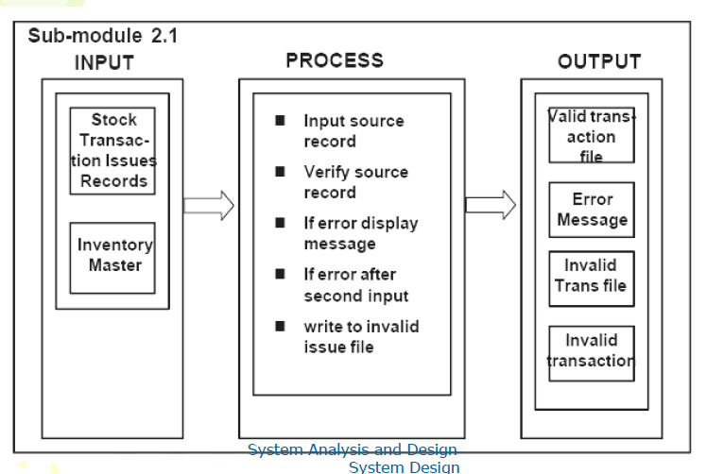
The HIPO Charts (Example)

Slide 37
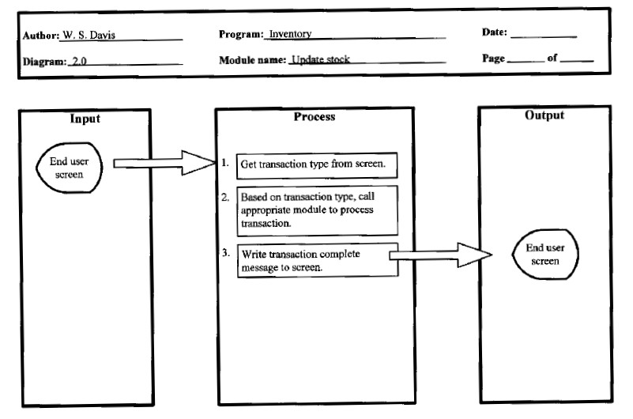
The HIPO Charts (Example)

Slide 38
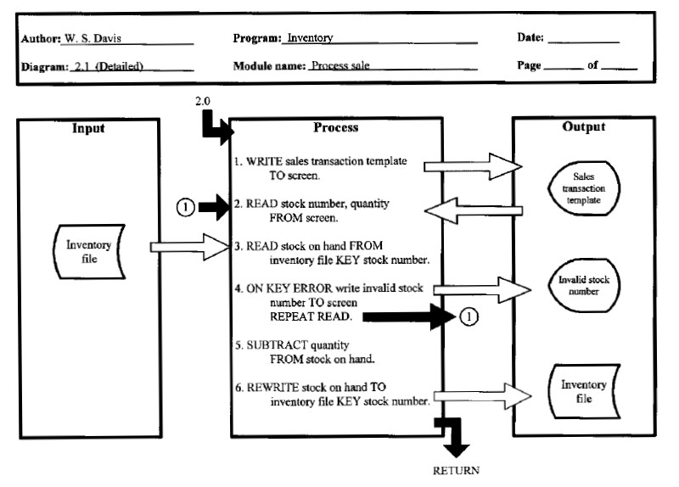
The HIPO Charts (Example)

Slide 39
The HIPO Charts (Example)

Slide 40
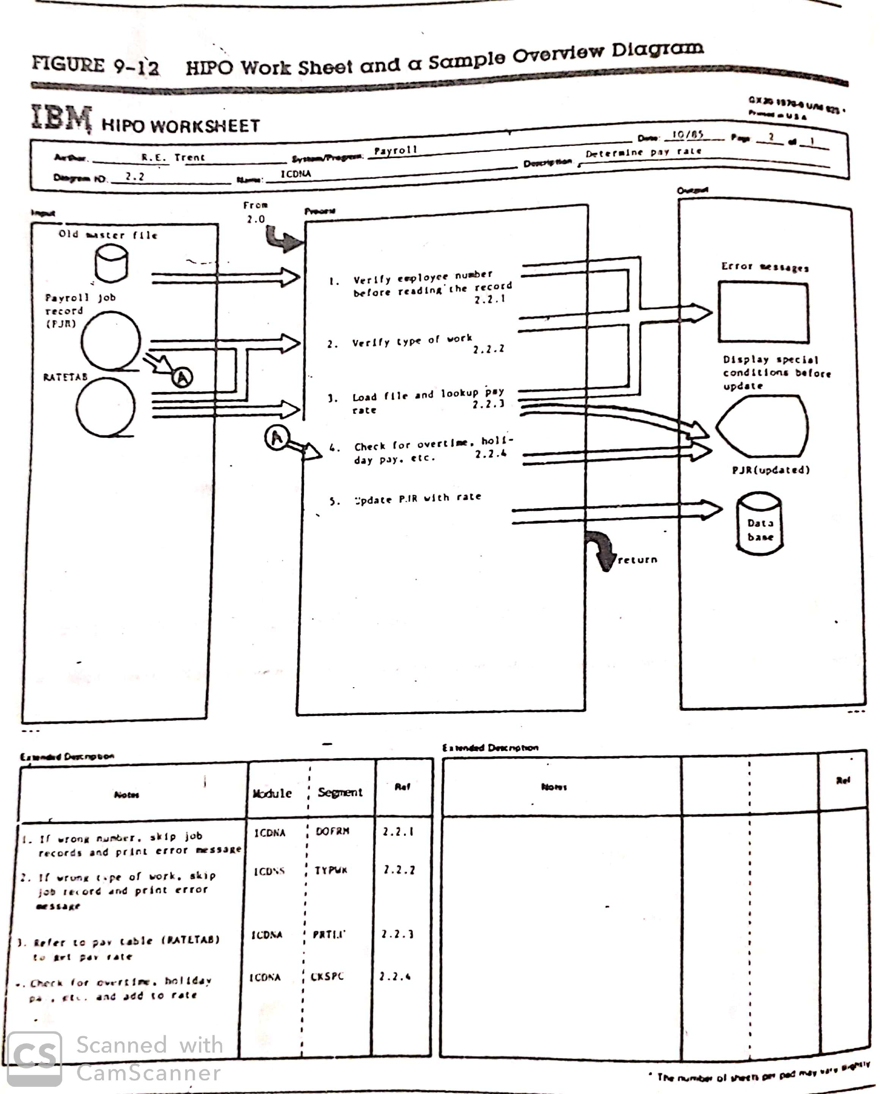
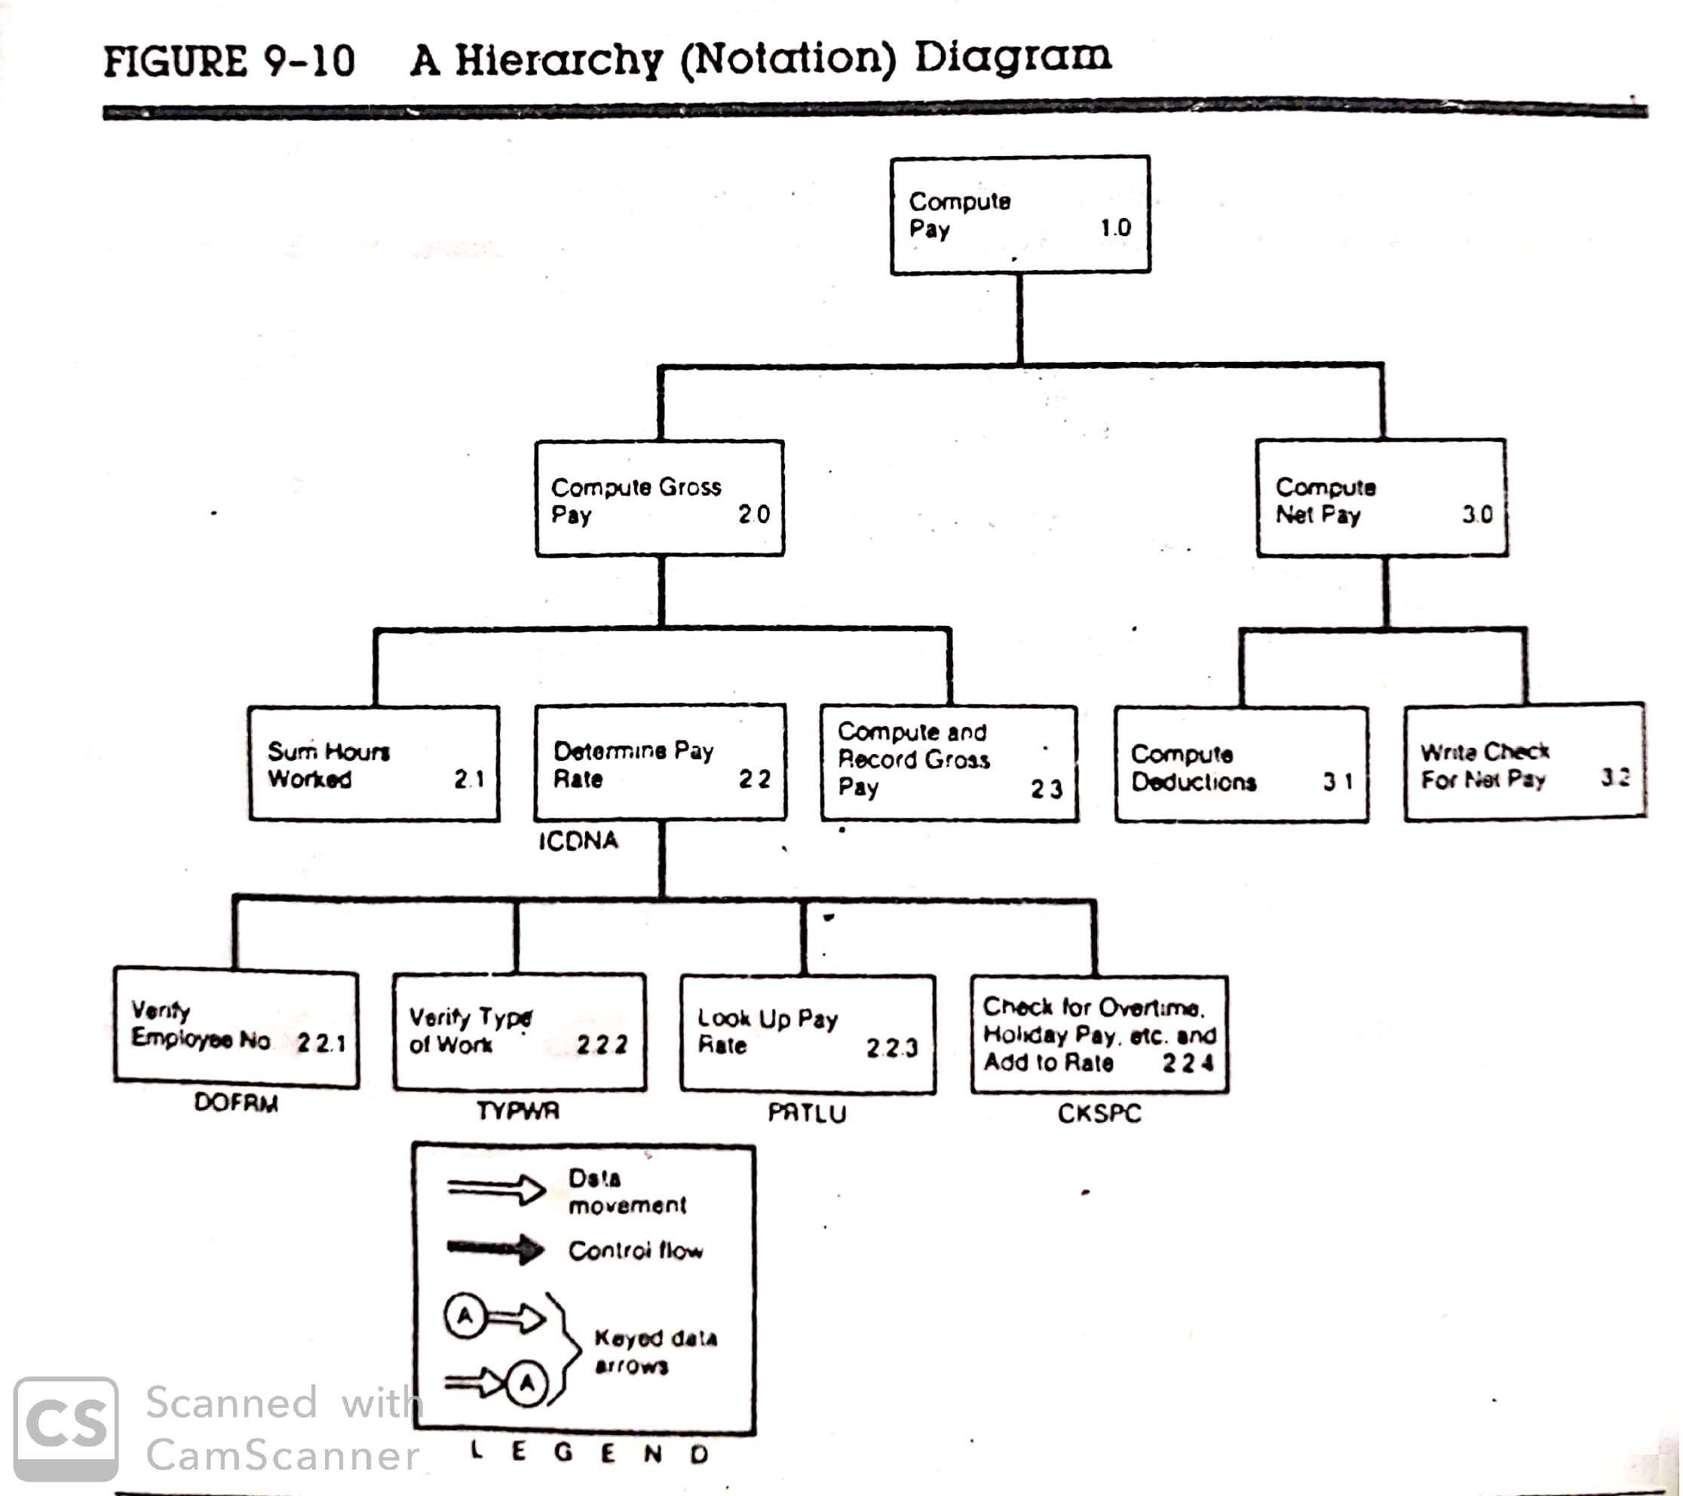
The HIPO Charts : IBM HIPO Worksheet

Slide 41
Structured Walkthrough
A static testing technique performed in an organized manner between a group of peers to review and discuss the technical aspects of software development process.
The main objective in a structured walkthrough is to find defects in order to improve the quality of the product.
Structured walkthroughs are usually NOT used for technical discussions or to discuss the solutions for the issues found.
The aim is to detect error and not to correct errors.
When the walkthrough is finished, the author of the output is responsible for fixing the issues.

Slide 42
Structured Walkthrough: Benefits
Saves time and money as defects are found and rectified very early in the lifecycle.
This provides value-added comments from reviewers with different technical backgrounds and experience.
It notifies the project management team about the progress of the development process.
It creates awareness about different development or maintenance methodologies which can provide a professional growth to participants.
It bridges the gap between the designer who as a “staff person” has an expert perspective, and the user, who is more typically “line” with a generalist or managerial view.

Slide 43
Structured Walkthrough: User Involvement
Walkthroughs may be held at various points in the system development lifecycle.
Structured walkthrough participants:
Author - The Author of the document under review.
Presenter - The presenter usually develops the agenda for the walkthrough and presents the output being reviewed.
Moderator - The moderator facilitates the walkthrough session, ensures the walkthrough agenda is followed, and encourages all the reviewers to participate.
Reviewers - The reviewers evaluate the document under test to determine if it is technically accurate.
Scribe - The scribe is the recorder of the structured walkthrough outcomes who records the issues identified and any other technical comments, suggestions, and unresolved questions

Slide 44
Auditing
It is an investigation to review the performance of an operational system.
A well-designed system should have controls to ensure proper operation and routine auditing.
A candidate system's failure often results from a lack of emphasis on data control.
Therefore, standards of accuracy, consistency, and maintainability must be specified to eliminate errors and control for fraud.

Slide 45
Auditing
The objectives of conducting a system audit are as follows –
To compare actual and planned performance.
To verify that the stated objectives of system are still valid in current environment.
To evaluate the achievement of stated objectives.
To ensure the reliability of computer based financial and other information.
To ensure all records included while processing.
To ensure protection from frauds.

Slide 46
Audit Considerations
Audit considerations examine the results of the analysis by using both the narratives and models to identify the problems caused due to misplaced functions, split processes or functions, broken data flows, missing data, redundant or incomplete processing, and non-addressed automation opportunities.
Identification of the current environment problems
Identification of problem causes
Identification of alternative solutions
Evaluation and feasibility analysis of each solution
Selection and recommendation of most practical and appropriate solution
Project cost estimation and cost benefit analysis

Slide 47
Audit Trail and Documentation Control
An audit trail or audit log is a security record which is comprised of who has accessed a computer system and what operations are performed during a given period of time.
Audit trials are used to do detailed tracing of how data on the system has changed.
It provides documentary evidence of various control techniques that a transaction is subject to during its processing.
Audit trials do not exist independently. They are carried out as a part of accounting for recovering lost transactions.
In a manual system, journals, ledgers are used to trace transactions through the system.
In a computerized system, magnetic medium – tape, disk, files are used to trace transactions through the system.
A documentation is also associated with audit trail that provides a reference for system maintenance.

Slide 48
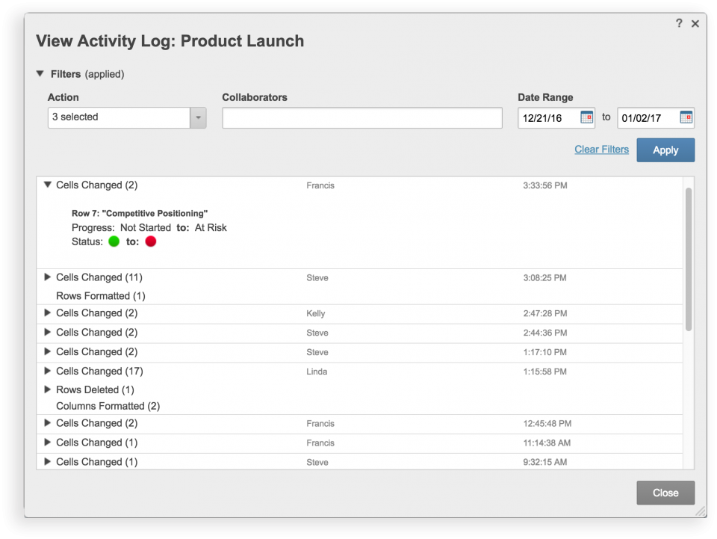
Audit Trail and Documentation Control

Slide 49
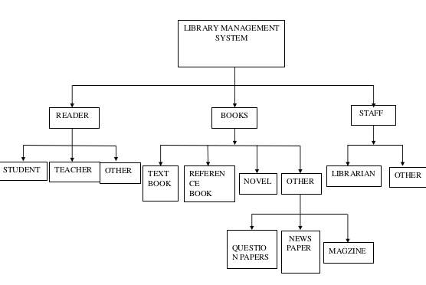
Practice: HIPO Chart

Slide 50
THANK YOU

